Slide 1
SUADİYE SECONDARY SCHOOL SAFRANBOLU HOUSES

Slide 2
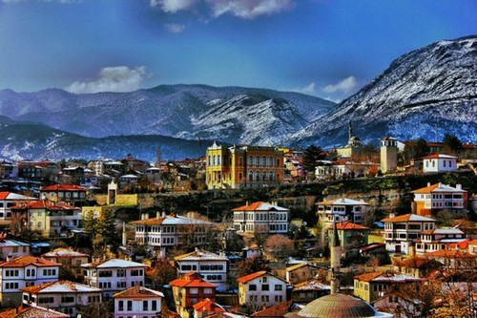
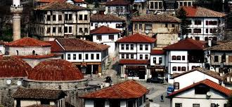
Kocaeli Kartepe Suadiye Secondary School
Safranbolu is a town and district of Karabük Province in the Black Sea region of Turkey. It is about 200 kilometres north of Ankara and about 100 km south of the Black Sea coast, or more precisely about 9 km north of the city of Karabük. Former Turkish names of the town were Zalifre and Taraklıborlu and in Greek Theodoroupolis, and latter Saframpolis. It was part of Kastamonu Province until 1923 and Zonguldak Province between 1923 and 1995.

Slide 3
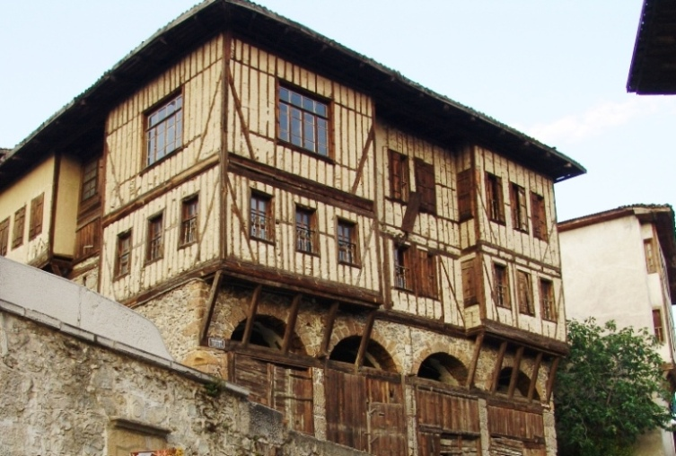
Kocaeli Kartepe Suadiye Secondary School
According to the 2000 census, the population of the district is 47,257, of which 31,697 live in the town of Safranbolu. The district covers an area of 1,000 km2 and the town lies at an elevation of 485 m.
The Old Town preserves many old buildings, with 1008 registered historical artifacts. These are: 1 private museum, 25 mosques, 5 tombs, 8 historical fountains, 5 Turkish baths, 3 caravanserais, 1 historical clock tower, 1 sundial and hundreds of houses and mansions. Also there are mounds of ancient settlements, rock tombs and historical bridges. The Old Town is situated in a deep ravine in a fairly dry area in the rain shadow of the mountains. The

Slide 4
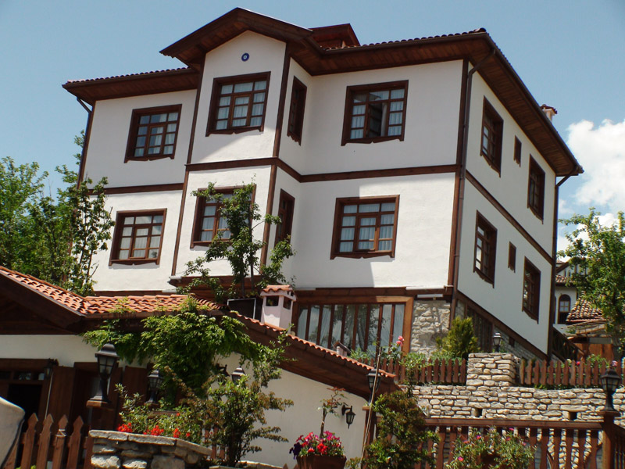
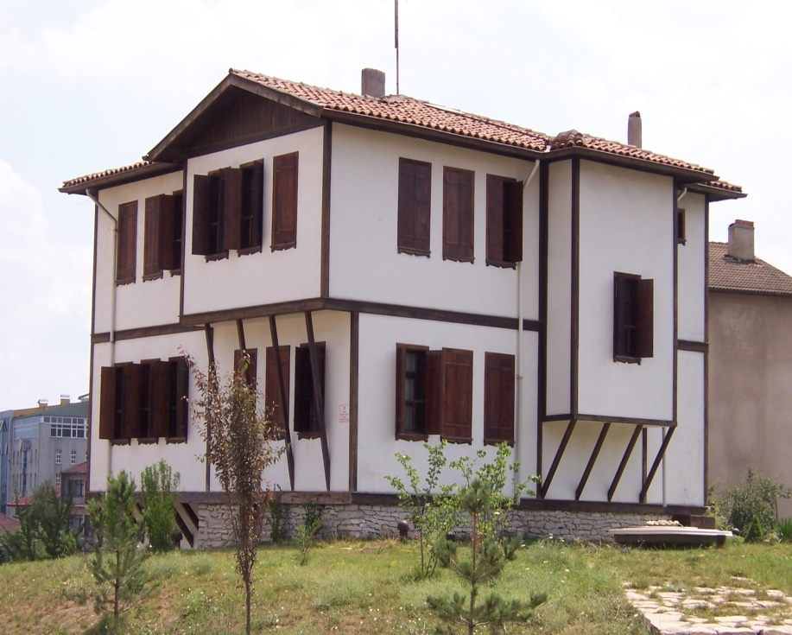
Kocaeli Kartepe Suadiye Secondary School
New Town can be found on the plateau about two kilometers west of the Old Town.
The name of the town derives from 'saffron' and the Greek word 'polis' (city),[citation needed] since Safranbolu was a trading place and a center for growing saffron. Today saffron is still grown at the village of Davutobası which is 22 km east of Safranbolu and probably one of the best quality saffrons in the world[citation needed].
Safranbolu was added to the list of UNESCO World Heritage sites in 1994 due to its well-preserved Ottoman era houses and architecture.

Slide 5
OUR MODEL WORKS

Slide 6
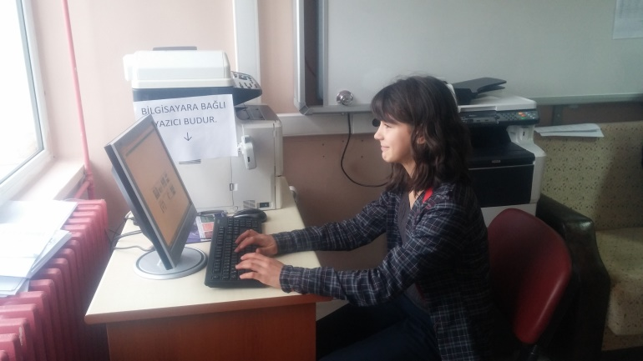
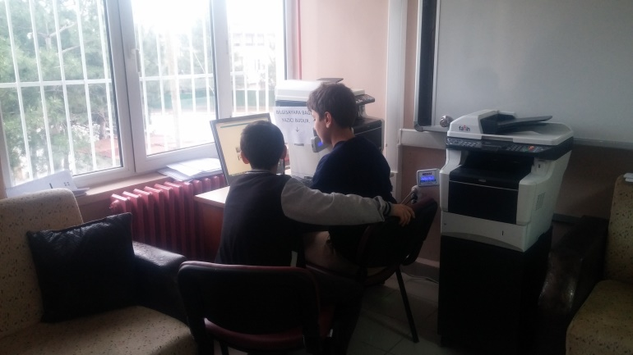
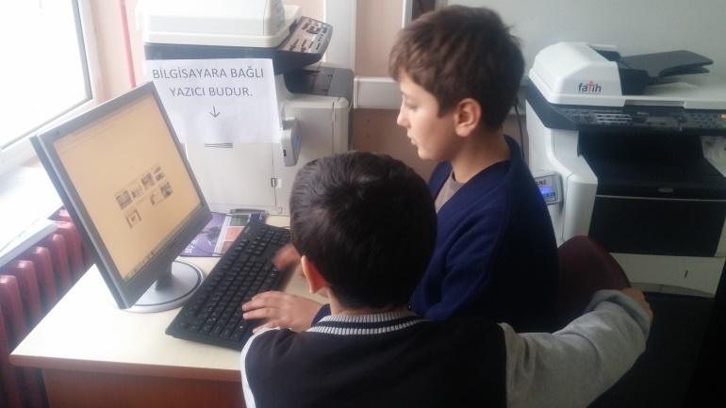
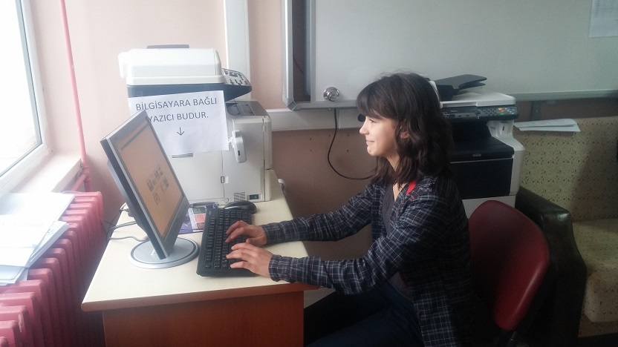
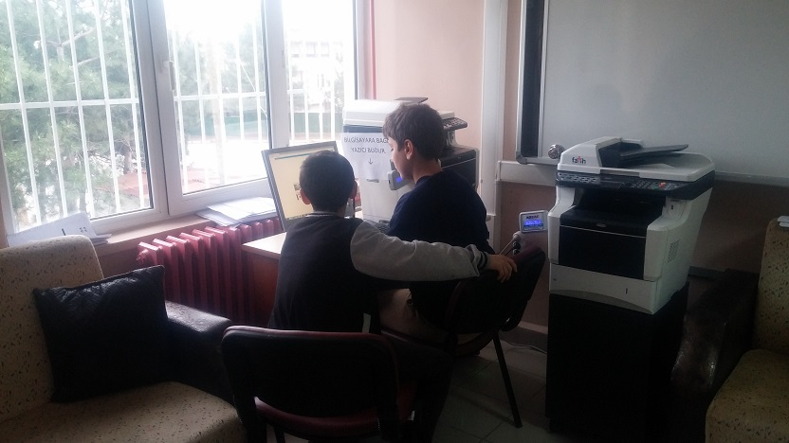
Kocaeli Kartepe Suadiye Secondary School
Our students are searching traditional Turkish Houses on internet

Slide 7
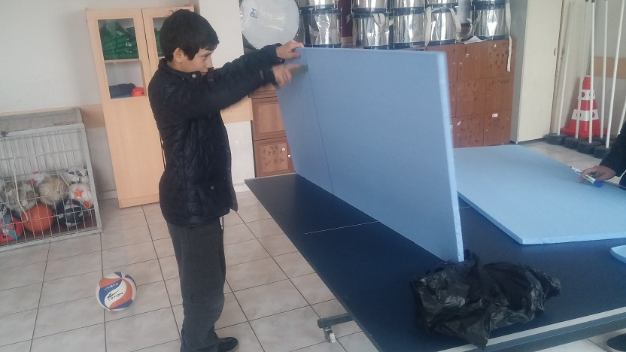
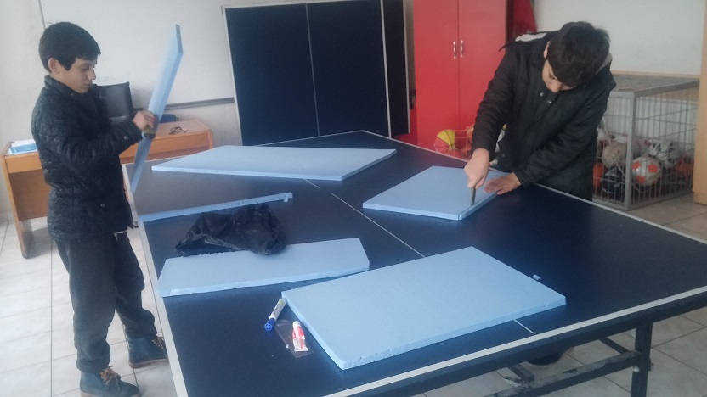
Kocaeli Kartepe Suadiye Secondary School
They have started to build.

Slide 8
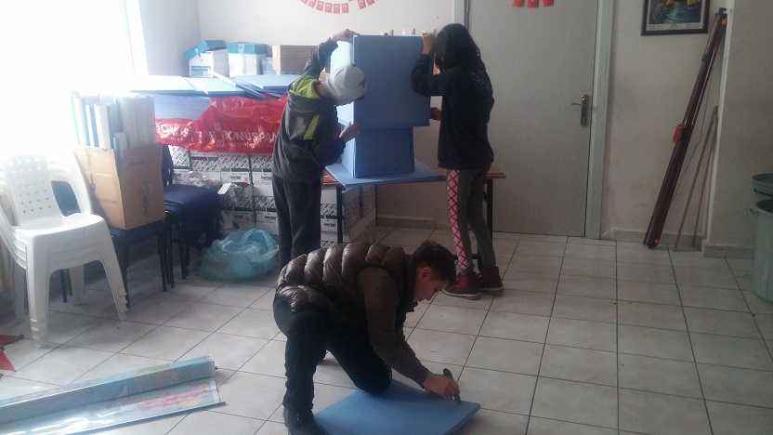
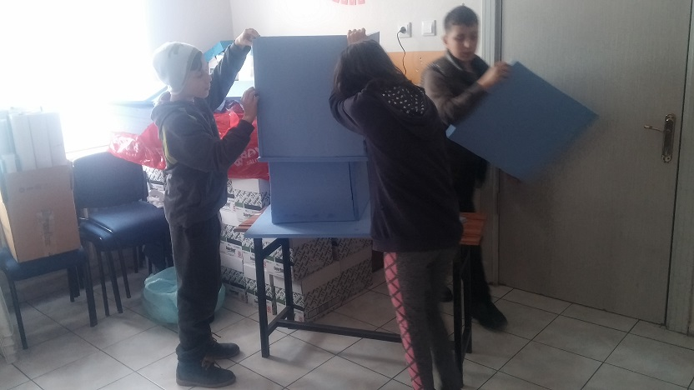
Kocaeli Kartepe Suadiye Secondary School

Slide 9
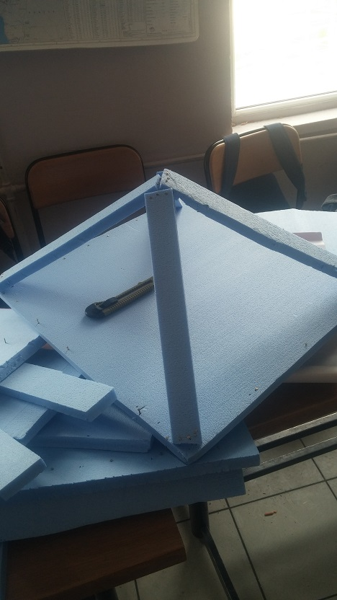
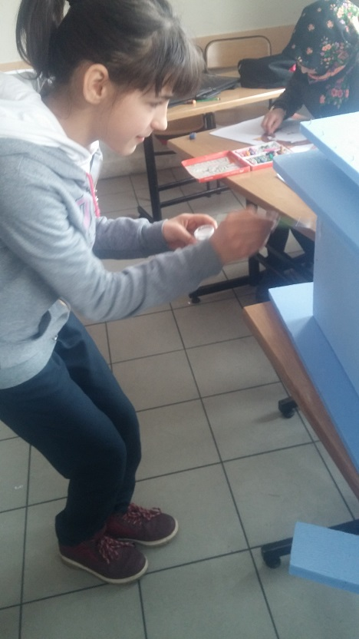
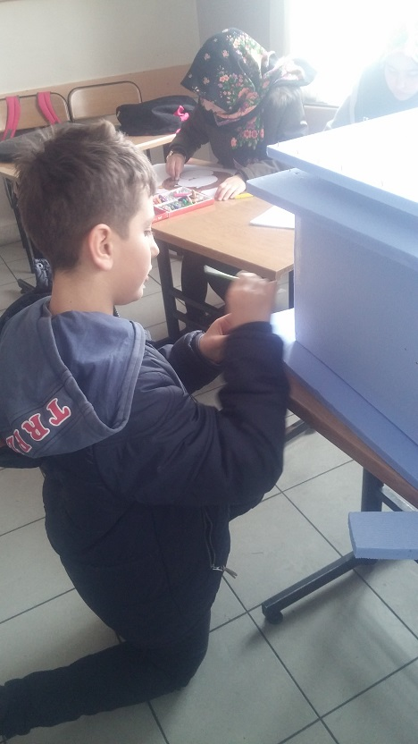
Kocaeli Kartepe Suadiye Secondary School

Slide 10
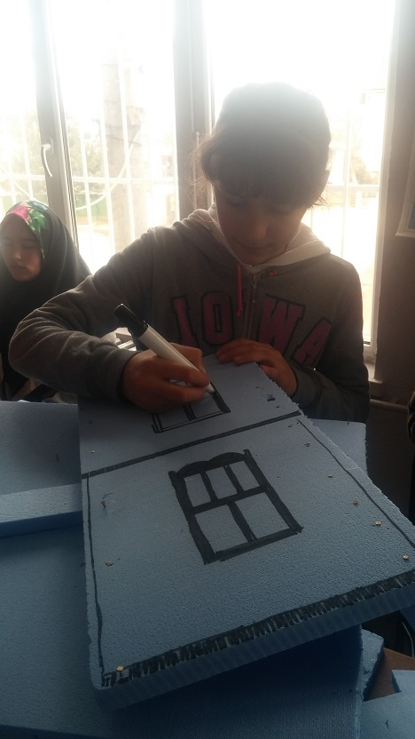
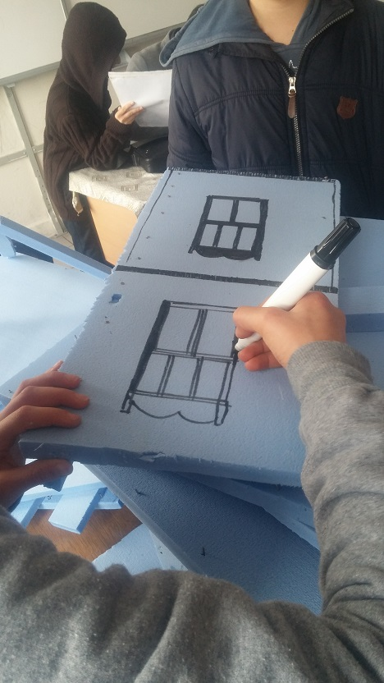
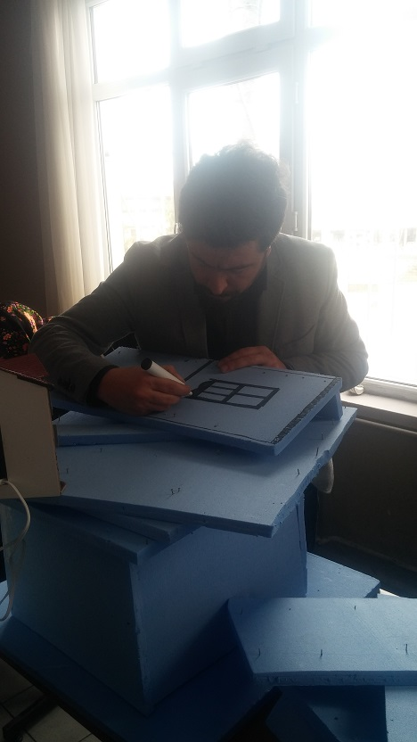
Kocaeli Kartepe Suadiye Secondary School

Slide 11
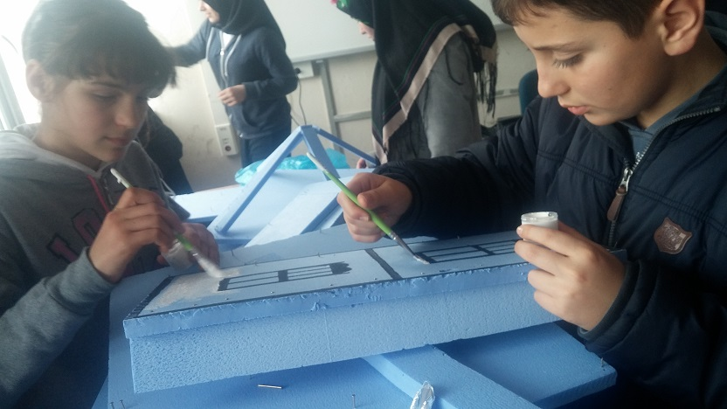
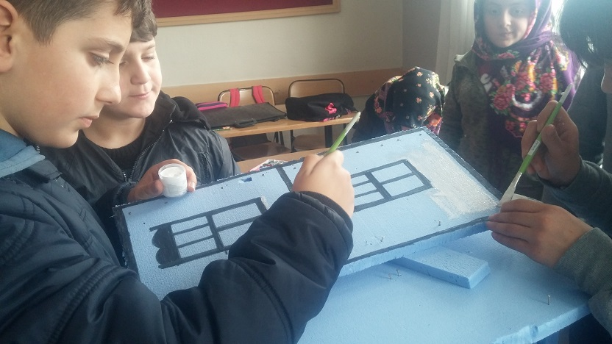
Kocaeli Kartepe Suadiye Secondary School

Slide 12
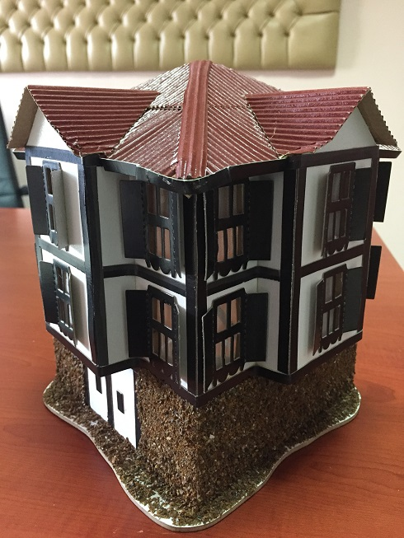
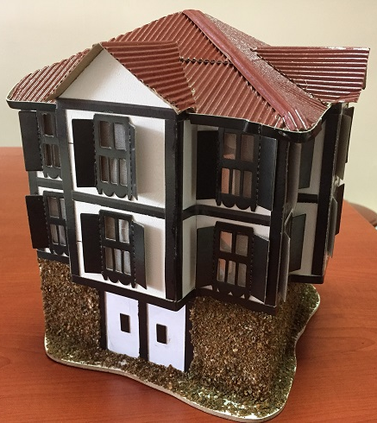
Kocaeli Kartepe Suadiye Secondary School

Slide 13
THANK YOU
TEŞEKKÜRLER

